Slide 1

Sales Performance Dashboard
Task 4: Dashboard Design
Data Analyst Internship – Elevate Labs
Tool Used: Tableau
Dataset: Sample Sales Data(Kaggle)

Slide 2
Objective & Dataset:
Objective:
To design an interactive dashboard that provides a clear overview of sales performance and helps business stakeholders analyze trends, products, and regional performance.
Dataset:
• Sample Sales Data
• 2,823 sales records
• Includes order, product, customer, sales, date, and geographical information.
Tools Used:
• Tableau
• CSV Dataset

Slide 3
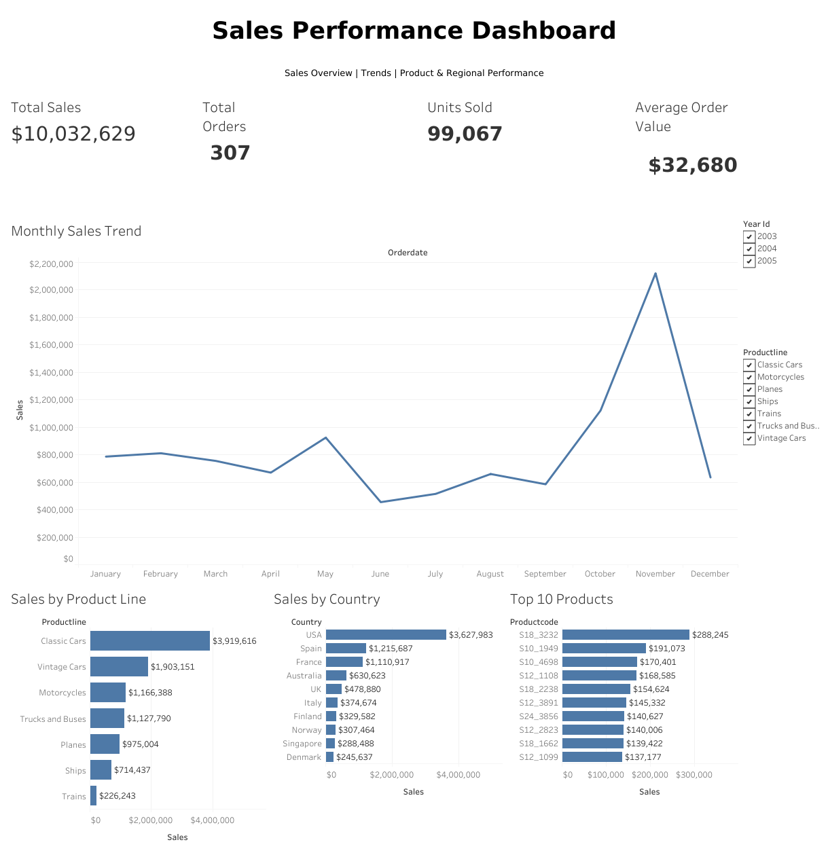
Dashboard Overview
1. Sales Performance Dashboard:-

Slide 4
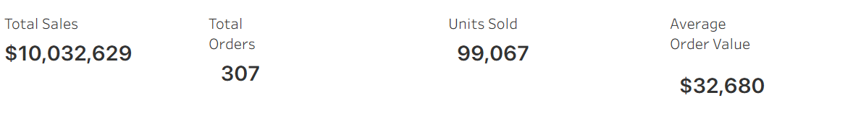
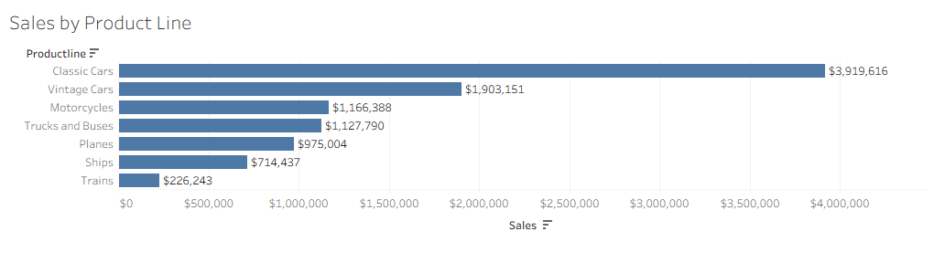
2. KPI cards, sales trends, product analysis, country-wise performance, and filters.

Slide 5
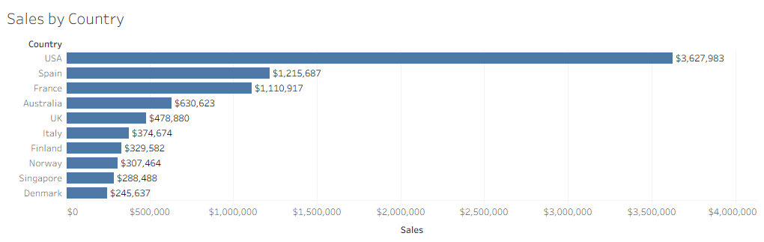
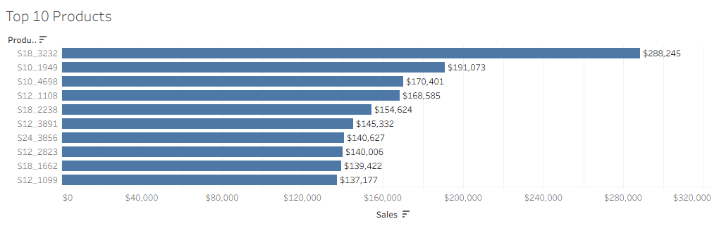

Slide 6
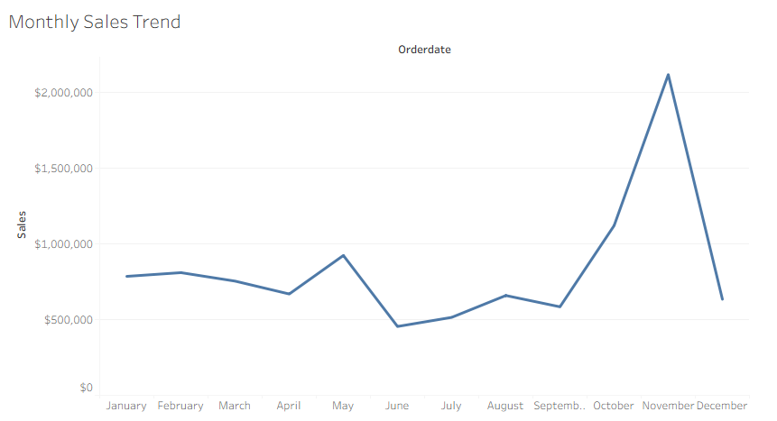

Slide 7
KPIs & Interactivity
Key Performance Indicators:-
• Total Sales — Overall revenue generated from the sales dataset.
• Total Orders — Number of unique orders.
• Units Sold — Total quantity of products sold.
• Average Order Value — Average sales value generated per order.
Interactive Filters:
• Year
• Product Line
*These filters allow users to dynamically explore the dashboard based on their selected criteria.

Slide 8
Visualizations & Key Insights
Dashboard Visualizations:
• Monthly Sales Trend — Identifies sales patterns across months.
• Sales by Product Line — Compares performance across product categories.
• Sales by Country — Highlights the top-performing markets.
• Top 10 Products — Identifies products generating the highest sales.
Key Insights:
• Sales performance varies across different months.
• Product lines contribute differently to overall sales.
• A limited number of countries account for a significant share of sales.
• Top products can be identified for better sales and inventory decisions.

Slide 9
Conclusion
The interactive dashboard provides a consolidated view of sales performance through KPIs, trends, product analysis, and geographical analysis.
Business Value
• Helps stakeholders monitor sales performance.
• Makes important sales trends easier to identify.
• Supports product and regional performance analysis.
• Enables interactive exploration using filters.
• Can assist in making data-driven business decisions.
Outcome
Designed an interactive Tableau dashboard to transform sales data into actionable business insights.

